Slide 1
22. Weighted Graphs; Shortest Path
ECE 309
Dr. James Tuck

Slide 2
Objectives
Describe weighted graphs, and give examples of what the weight might mean.
Describe how Dijkstra’s shortest path algorithm works; implement it in C++ code.

Slide 3
Weighted Graphs
A weighted graph associates a weight with each edge.
An edge's weight, or cost, represents some numerical value between vertices:
Flight cost between airports
connection speed between computers
travel time between cities.
A weighted graph may be directed or undirected.

Slide 4
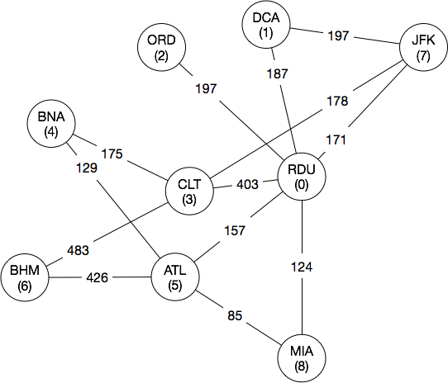
Example (1) of weighted graphs
Each node is an airport.
An edge represents a direct flight.
The weight is the cheapest cost of a non-stop flight as reported by Google.

Slide 5
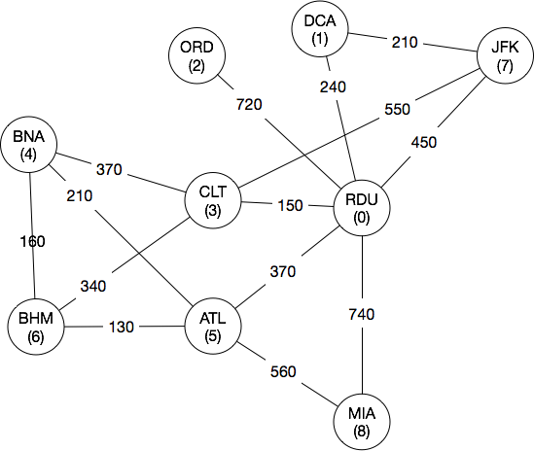
Example (2) of weighted graphs
Each node is a city.
An edge represents highways between two cities.
The weight is the time to drive the fastest path between them as reported by Google Maps.

Slide 6
Representation of weighted graphs
Two general strategies (variations possible):
Adjacency lists with extra information stored in each list-node.
Adjacency matrix with a corresponding weight matrix.

Slide 7
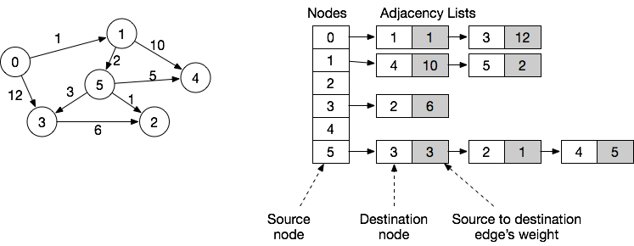
Adjacency list with weight information
For each entry in the adjacency list, an object holds the adjacent node’s number and the weight on the edge to get there.

Slide 8
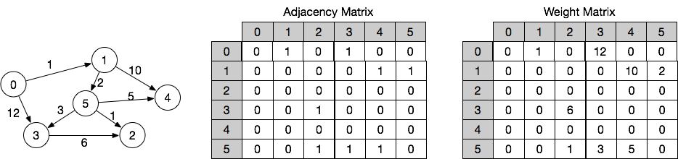
Adjacency matrix with weight information
For each edge in the adjacency matrix, the weight matrix holds its weight.
Alternative design: make each entry in the matrix a class with two fields: a boolean to indicate if the edge exists, and an integer to hold the weight.

Slide 9
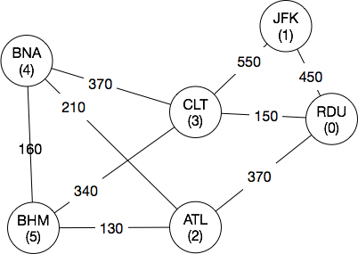
Example
Represent the weighted graph shown below in code.
What’s the shortest route from RDU to BHM?

Slide 10
Dijkstra’s Shortest Path Algorithm
Problem: find the shortest (least-weight) path from a start vertex to all other vertices.
Basic idea (informal):
Initialize the distance from start to all other nodes as ∞.
Pick next closest node to start, X, and determine the distance from X to all of its adjacent nodes, Y:
if X to Y is the smallest distance found so far, update distance from start to Y to be Y’s new shortest distance.
Go back to 2 until completed for all nodes.

Slide 11
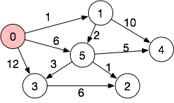
Shortest path example (#1)
 | Distance to node from 0
Node | 0 | 1 | 2 | 3 | 4 | 5
0 | 0 | ∞ | ∞ | ∞ | ∞ | ∞
Start at node 0.

Slide 12
Shortest path example (#2)
 | Distance to node from 0
Node | 0 | 1 | 2 | 3 | 4 | 5
0 | 0 | 1 | ∞ | 12 | ∞ | 6
Check each adjacent node to 0, and update distance calculation.

Slide 13
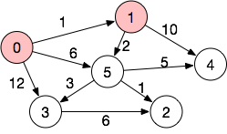
Shortest path example (#3)
 | Distance to node from 0
Node | 0 | 1 | 2 | 3 | 4 | 5
0 | 0 | 1 | ∞ | 12 | ∞ | 6
1
1 is smallest distance, visit 1 next.

Slide 14
Shortest path example (#4)
 | Distance from node 0 to:
Node | 0 | 1 | 2 | 3 | 4 | 5
0 | 0 | 1 | ∞ | 12 | ∞ | 6
1 | 0 | 1 | ∞ | 12 | 11 | 3
Update distance from 1 to it’s adjacent nodes, if the new distance is smaller.
Distance(4) = min(Distance(1)+10,∞) = 11
Distance(5) = min(Distance(1)+2, 6) = 3

Slide 15
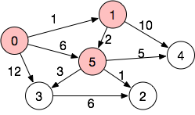
Shortest path example (#5)
 | Distance from node 0 to:
Node | 0 | 1 | 2 | 3 | 4 | 5
0 | 0 | 1 | ∞ | 12 | ∞ | 6
1 | 0 | 1 | ∞ | 12 | 11 | 3
5 | 0 | 1 | 4 | 6 | 8 | 3
Pick unvisited node with smallest distance, node 5.
Update adjacent node’s distance.

Slide 16
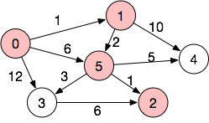
Shortest path example (#6)
 | Distance from node 0 to:
Node | 0 | 1 | 2 | 3 | 4 | 5
0 | 0 | 1 | ∞ | 12 | ∞ | 6
1 | 0 | 1 | ∞ | 12 | 11 | 3
5 | 0 | 1 | 4 | 6 | 8 | 3
2 | 0 | 1 | 4 | 6 | 8 | 3
Pick unvisited node with smallest distance, node 2.
Node 2 has no adjacent nodes!

Slide 17
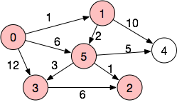
Shortest path example (#7)
 | Distance from node 0 to:
Node | 0 | 1 | 2 | 3 | 4 | 5
0 | 0 | 1 | ∞ | 12 | ∞ | 6
1 | 0 | 1 | ∞ | 12 | 11 | 3
5 | 0 | 1 | 4 | 6 | 8 | 3
2 | 0 | 1 | 4 | 6 | 8 | 3
3 | 0 | 1 | 4 | 6 | 8 | 3
Pick unvisited node with smallest distance, node 3.
Distance(2) = min(4, Distance(3)+6)
= 4 (no change)
3 is not on the shortest path to 2.

Slide 18
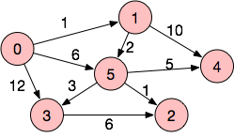
Shortest path example (#8)
 | Distance from node 0 to:
Node | 0 | 1 | 2 | 3 | 4 | 5
0 | 0 | 1 | ∞ | 12 | ∞ | 6
1 | 0 | 1 | ∞ | 12 | 11 | 3
5 | 0 | 1 | 4 | 6 | 8 | 3
2 | 0 | 1 | 4 | 6 | 8 | 3
3 | 0 | 1 | 4 | 6 | 8 | 3
4 | 0 | 1 | 4 | 6 | 8 | 3
Pick last unvisited node, node 4.
Node 4 has no adjacent nodes.
Last row of table shows shortest distance to each node from 0.

Slide 19
Dijkstra’s shortest path pseudocode
DijkstraShortestPath(startV) { for each vertex currentV in graph { currentV->distance = Infinity currentV->predV = 0 Push currentV to unvisitedQueue } // startV has a distance of 0 from itself startV->distance = 0 while (unvisitedQueue is not empty) { // Visit vertex with minimum distance from startV currentV = PopMin unvisitedQueue for each vertex adjV adjacent to currentV { edgeWeight = weight of edge from currentV to adjV alternativePathDistance = currentV->distance + edgeWeight // If shorter path from startV to adjV is found, // update adjV's distance and predecessor if (alternativePathDistance < adjV->distance) { adjV->distance = alternativePathDistance adjV->predV = currentV } } } }

Slide 20
Dijkstra’s shortest path pseudocode
DijkstraShortestPath(startV) { for each vertex currentV in graph { currentV->distance = Infinity currentV->predV = 0 Push currentV to unvisitedList } // startV has a distance of 0 from itself startV->distance = 0 while (unvisitedList is not empty) { // Visit vertex with minimum distance from startV currentV = PopMin unvisitedList for each vertex adjV adjacent to currentV { edgeWeight = weight of edge from currentV to adjV alternativePathDistance = currentV->distance + edgeWeight // If shorter path from startV to adjV is found, // update adjV's distance and predecessor if (alternativePathDistance < adjV->distance) { adjV->distance = alternativePathDistance adjV->predV = currentV } } } }
Initialization, collect nodes into a list

Slide 21
Dijkstra’s shortest path pseudocode
DijkstraShortestPath(startV) { for each vertex currentV in graph { currentV->distance = Infinity currentV->predV = 0 Push currentV to unvisitedList } // startV has a distance of 0 from itself startV->distance = 0 while (unvisitedList is not empty) { // Visit vertex with minimum distance from startV currentV = PopMin unvisitedList for each vertex adjV adjacent to currentV { edgeWeight = weight of edge from currentV to adjV alternativePathDistance = currentV->distance + edgeWeight // If shorter path from startV to adjV is found, // update adjV's distance and predecessor if (alternativePathDistance < adjV->distance) { adjV->distance = alternativePathDistance adjV->predV = currentV } } } }
Initial condition, start node has 0 distance.

Slide 22
Dijkstra’s shortest path pseudocode
DijkstraShortestPath(startV) { for each vertex currentV in graph { currentV->distance = Infinity currentV->predV = 0 Push currentV to unvisitedList } // startV has a distance of 0 from itself startV->distance = 0 while (unvisitedList is not empty) { // Visit vertex with minimum distance from startV currentV = PopMin unvisitedList for each vertex adjV adjacent to currentV { edgeWeight = weight of edge from currentV to adjV alternativePathDistance = currentV->distance + edgeWeight // If shorter path from startV to adjV is found, // update adjV's distance and predecessor if (alternativePathDistance < adjV->distance) { adjV->distance = alternativePathDistance adjV->predV = currentV } } } }
Visit each node in the graph one time, in ascending order of distance. Starting with the specified start node.
This outer loop will run V (number of vertices) times.
Finding the minimum (PopMin) with linear search: O(V)
Total: O(V*V)

Slide 23
Dijkstra’s shortest path pseudocode
DijkstraShortestPath(startV) { for each vertex currentV in graph { currentV->distance = Infinity currentV->predV = 0 Push currentV to unvisitedList } // startV has a distance of 0 from itself startV->distance = 0 while (unvisitedList is not empty) { // Visit vertex with minimum distance from startV currentV = PopMin unvisitedList for each vertex adjV adjacent to currentV { edgeWeight = weight of edge from currentV to adjV alternativePathDistance = currentV->distance + edgeWeight // If shorter path from startV to adjV is found, // update adjV's distance and predecessor if (alternativePathDistance < adjV->distance) { adjV->distance = alternativePathDistance adjV->predV = currentV } } } }
Visit each adjacenct node (adjV) to currentV.
Calculate distance from currentV to adjV.
If it’s shorter, update adjV’s distance.

Slide 24
Dijkstra’s shortest path pseudocode
DijkstraShortestPath(startV) { for each vertex currentV in graph { currentV->distance = Infinity currentV->predV = 0 Push currentV to unvisitedList } // startV has a distance of 0 from itself startV->distance = 0 while (unvisitedList is not empty) { // Visit vertex with minimum distance from startV currentV = PopMin unvisitedList for each vertex adjV adjacent to currentV { edgeWeight = weight of edge from currentV to adjV alternativePathDistance = currentV->distance + edgeWeight // If shorter path from startV to adjV is found, // update adjV's distance and predecessor if (alternativePathDistance < adjV->distance) { adjV->distance = alternativePathDistance adjV->predV = currentV } } } }
This loop will in total run E (number of edges) times, once for each edge.

Slide 25
Dijkstra’s Shortest Path complexity
Version of Algorithm | Complexity | Explanation
Linear search in PopMin | O(V² + E) | The main loop must iterate one time for each vertex. In that iteration, we must pick the node at minimum distance from the start node by looping through all nodes in visitedList. Worst case V*V. We must also perform E comparisons, to find shortest path.
Efficient search in PopMin | O(V log V + E) | The main loop must iterate one time for each vertex. We can pick the minimum using a min-heap, in log V time. (Min is at head, but we must down percolate each time). Hence, V log V. We must also perform E comparisons, to find shortest path.

Slide 26
Some restrictions for Dijkstra’s algorithm
It doesn’t work on graphs with negative weights. Why?
Because it relies on visiting nodes in order of longer distances.
Negative weights mean that node’s distances can drop in value, invalidating an assumption of the algorithm.
For an example, work ZyBook Activity 6.8.5.

Slide 27
Summary
Dijkstra’s shortest path algorithm computes the shortest path between two vertices in a graph taking weights on edges into account.
We can implement Dijkstra’s algorithm on directed or un-directed graphs.
We must avoid graphs that contain a cycle with a negative weighted edge

Slide 28
References
1. ZyBook on Data Structures, chapter 6.7

